Slide 1
Dominic P.
My year in review

Slide 2
About Me
Love to read, cook, play games
6 year old son
2 year old daughter
Married 13 years
Math degree from UW
Masters from WGU
5 years at PNNL
7th year teaching

Slide 3
Successes
Blender/art
GitHub
Tiled/SuperTiledtoUnity
….

Slide 4
Challenges
Communication with peers
Organization
Easily distractable
….

Slide 5
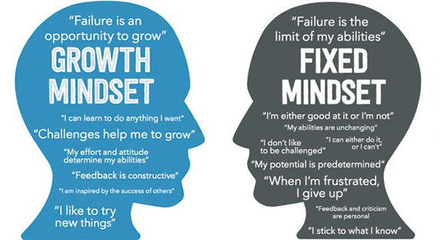
Personal Satisfaction

Slide 6
Career Plans
Continue leaning more coding languages
Game development
Participate in game jams
Or cyber security
….

Slide 7
Tri-Tech Advantages/Disadvantages
Advantages:
Long periods
Meet students with similar interests
Disadvantages:
Weird schedules
IT

Slide 8
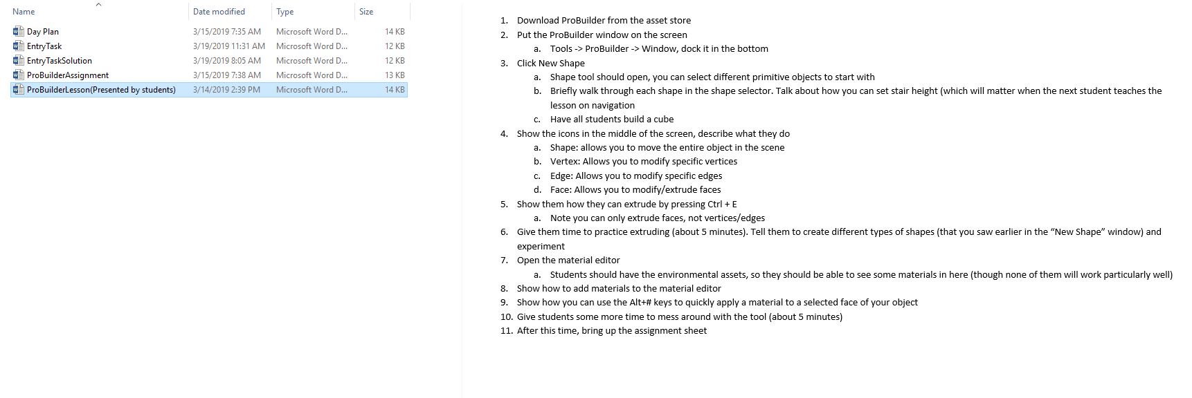
Work Examples

Slide 9
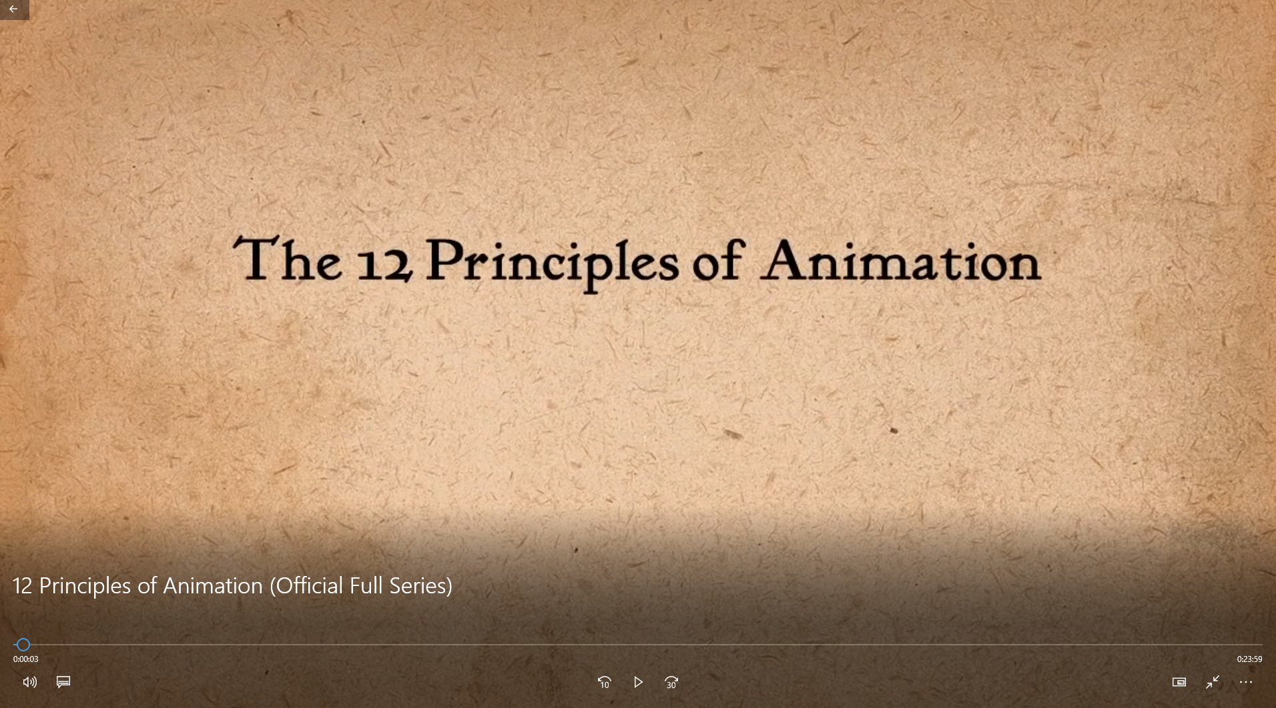
Work Examples

Slide 10
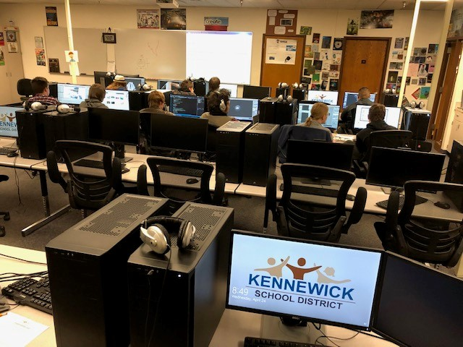
Work Examples

Slide 11
Work Examples

Slide 12
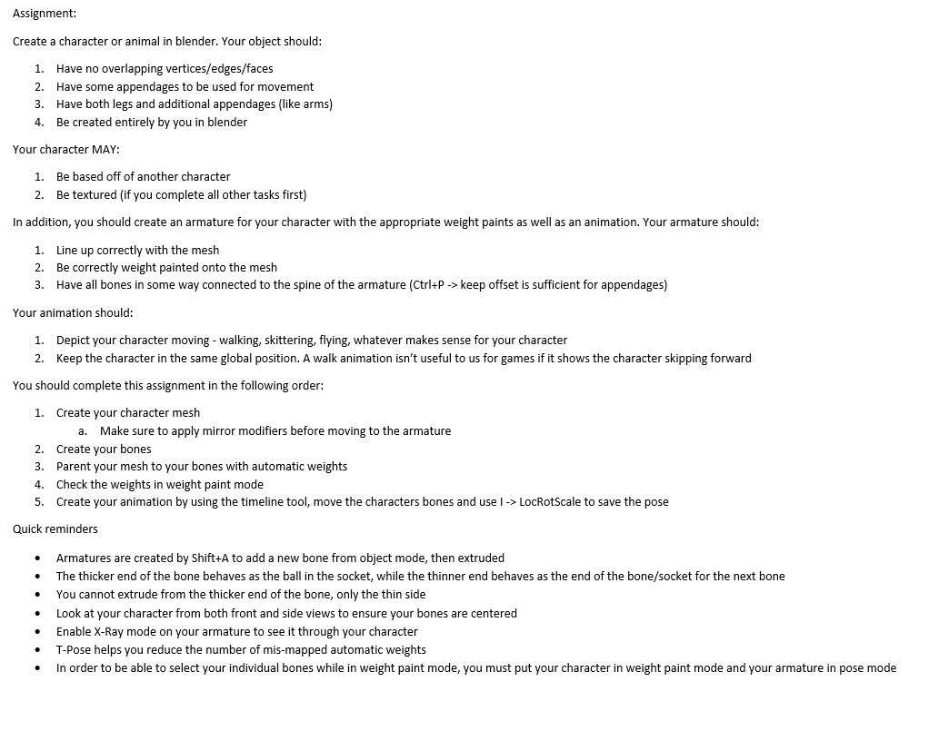
Work Examples

Slide 13
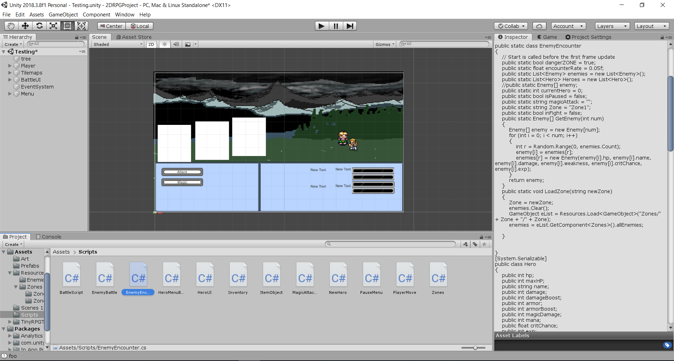
Work Examples

